Slide 1
Lesson 5 Multiple pages

Slide 2
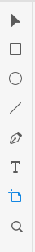
Creating another page
One page design might not require customer needs so we need to make another page.
This page would list for example all cars available near by.
To create another page choose Artboard tool from menu
Then click on some empty area of your design area, tool should create you a empty page. Which has the same size as your first page.
Artboard tool

Slide 3
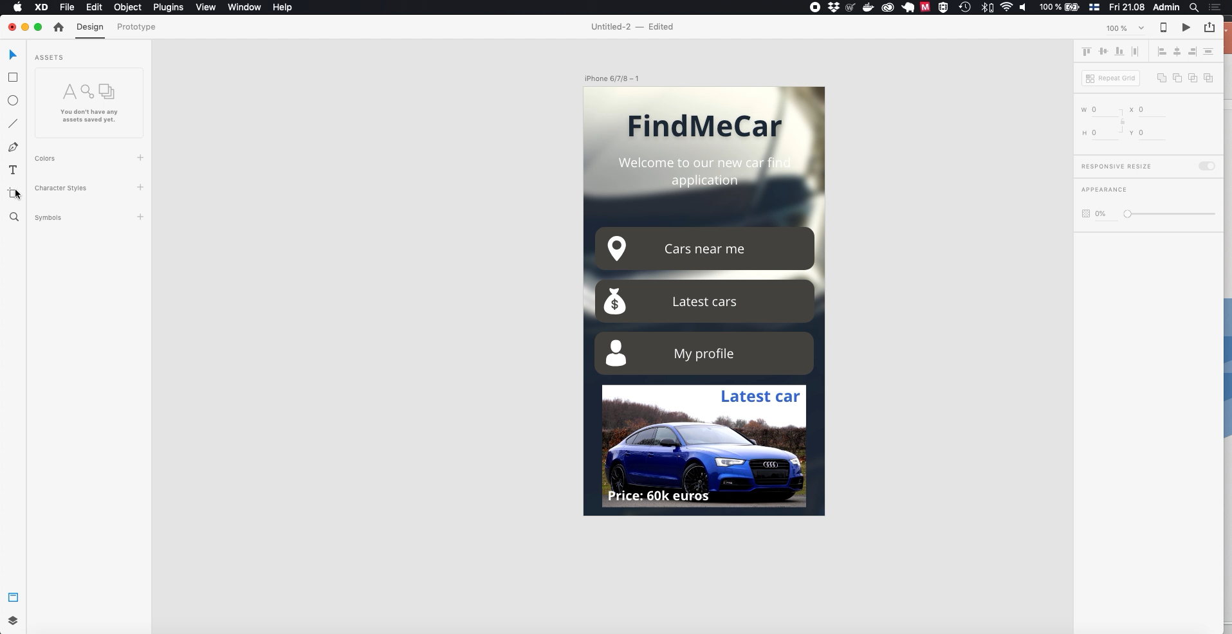

Slide 4
Working with symbols
You possibly want to use same objects trough out your pages.
For this you can create what AdobeXD calls as symbols.
When you create symbol you can use it everywhere on your design and once you change one instance of symbols every instance is changed.
Good objects for symbols are background images, logos, etc..

Slide 5
Working with symbols
To create symbols choose obect you want to be as symbol and then right-click it (or CTRL click) and choose ”Make symbol”
All your symbols are on left pane and you can drag them from there to any page
Now let’s make our background to be a symbol and place it on the second page.
IMPORTANT: We forgot to group our blurring layer and background image, so lets first choose both of them and make group. To do this we can use rectangular selector.

Slide 6
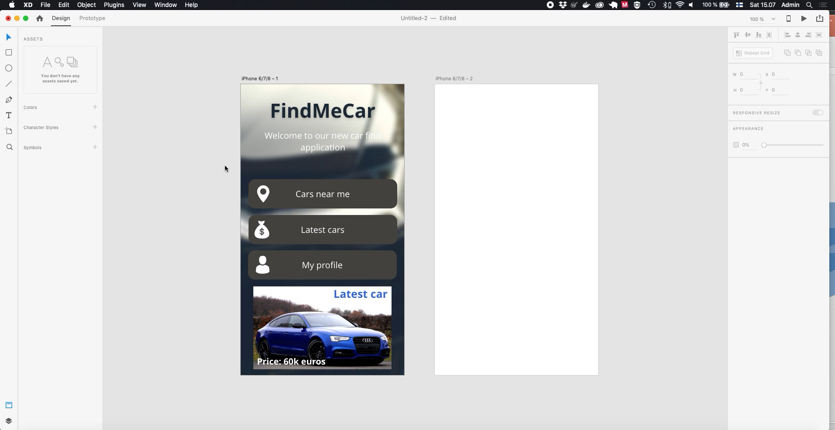

Slide 7
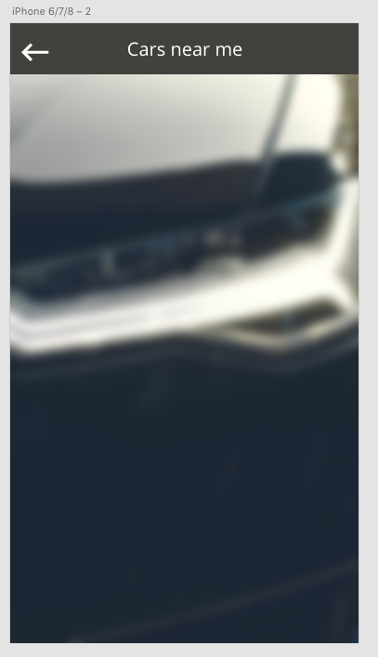
Adding details to second page
For the second page we will make option to go back to first page and list of cars that can be found near user.
You can use your own design or follow next videos. In the first video we will create option to go back to first page

Slide 8
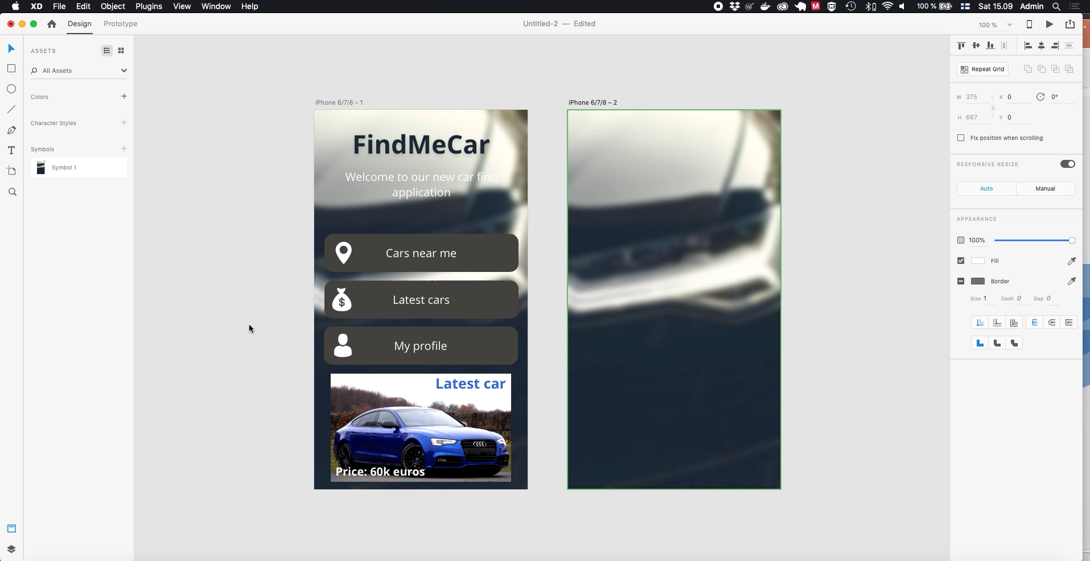

Slide 9
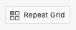
Adding details to second page
Next we will add list to display cars. To do this we use new feature called ”Repeat Grid”
When using ”Repeat Grid” you can make grid of items. Your first item is replicated in horizontal and/or vertical direction as many times as you like.
Repeat Grid items can be changed individually

Slide 10
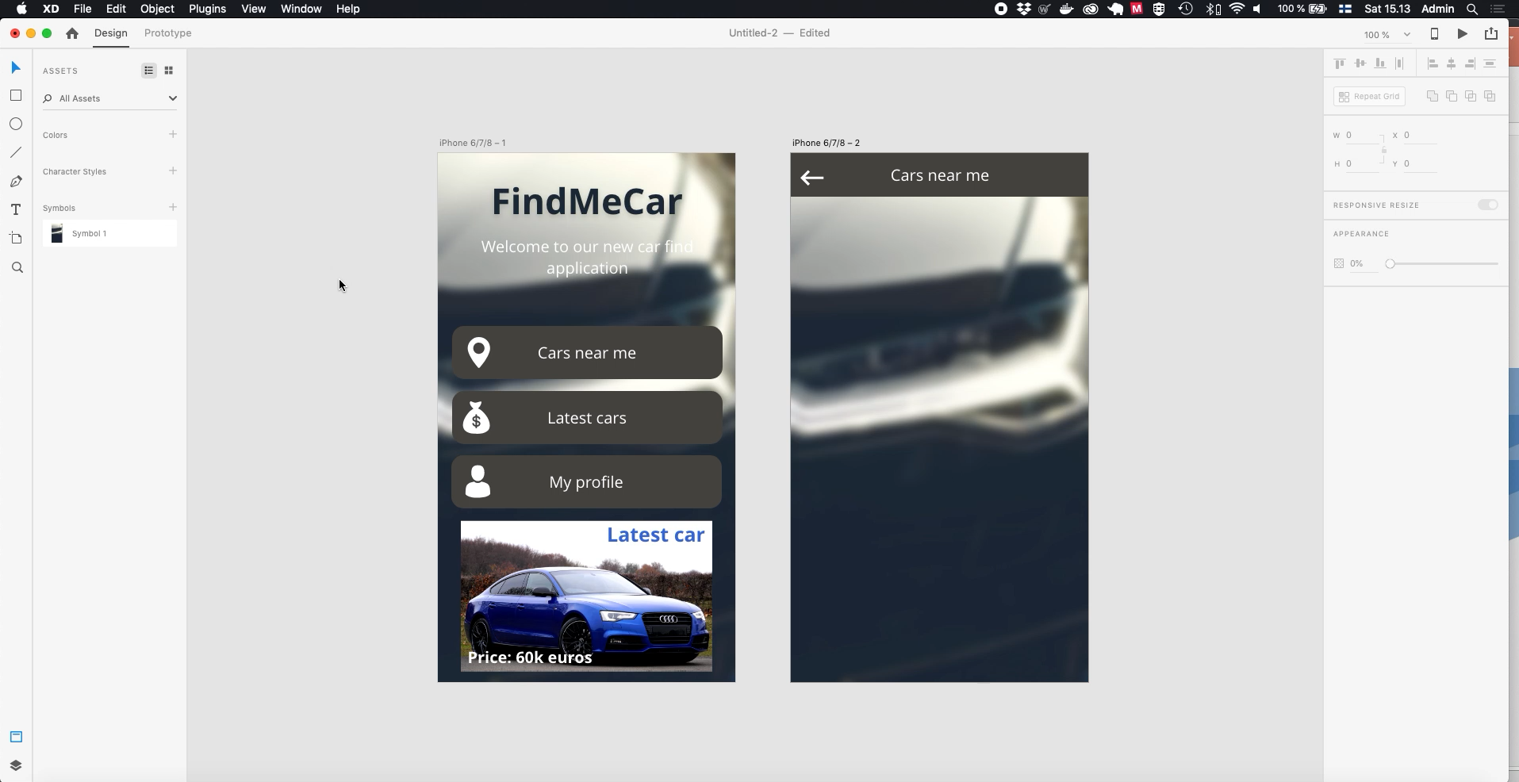

Slide 11
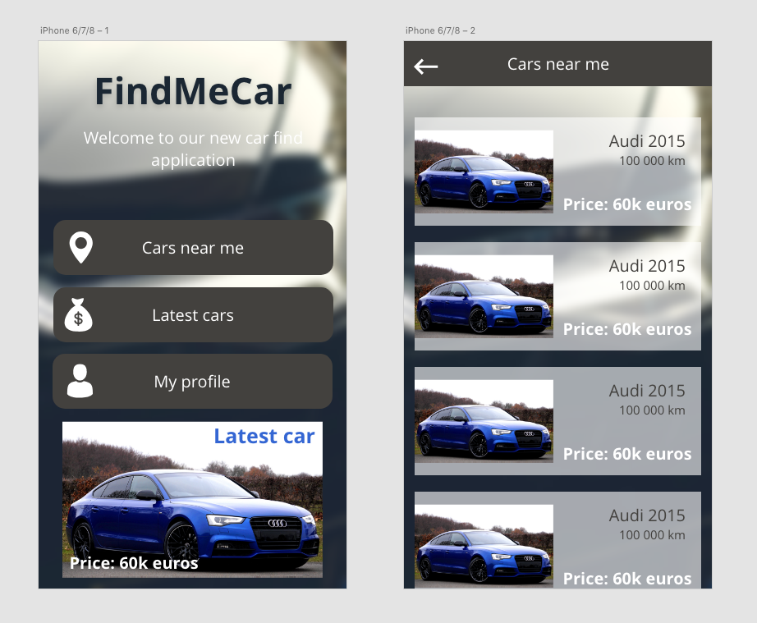
Ready made design
This is our ready made design. Now we are ready to add interaction and make this as a working prototype.
It has only two pages, but it’s enough to learn how interaction can be made

Slide 12
Lesson 6 Prototyping

Slide 13
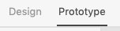
Prototyping
In prototyping you create interaction between objects and pages.
Interaction you create can be used by user when you publish prototype
To start creating prototype select ”Prototype” from top menu. In prototyping mode you cannot add objects, but instead you can add/modify/delete interactions
Access prototyping from top menu

Slide 14
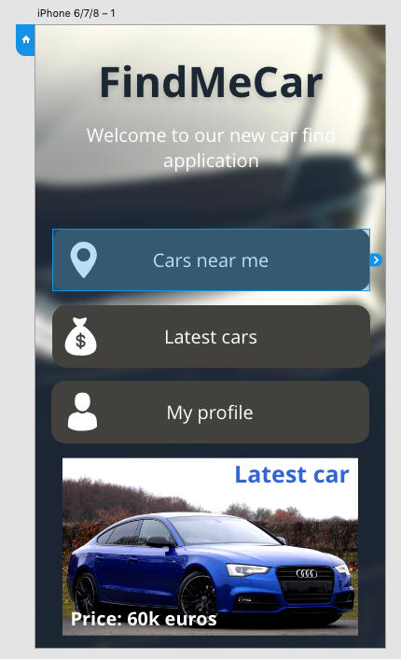
Prototyping
Indicates start page (click to change)
In protyping mode you can choose objects and once chosen they will have blue overlay and border, like in picture at left.
Once object is chosen, you can make it interactive by dragging interaction trigger to the page you want user to be directred when they interract with object
Interaction trigger

Slide 15
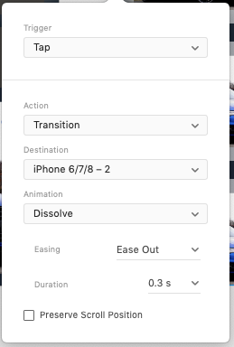
Prototyping
For each interaction you can have multiple options.
Trigger states how user can access this interaction
Tap happens when user clicks or taps item
Drag happens user drags item
Action is what occurs when interaction is detect, most common ones are
Transition to another page
Transition to previous page

Slide 16
Prototyping
Animation defines how transition happens. For example you can change new page to slide in from left or right.
Easing defines how animation is done, best options are None or Ease Out. And duration of animation can also be set

Slide 17
Prototyping
Next we will create interaction from first page to second page.
To do this select ”Cars near me” drag its interaction trigger to second page, and choose appropriate interaction options.
And do same for back icon at second page

Slide 18
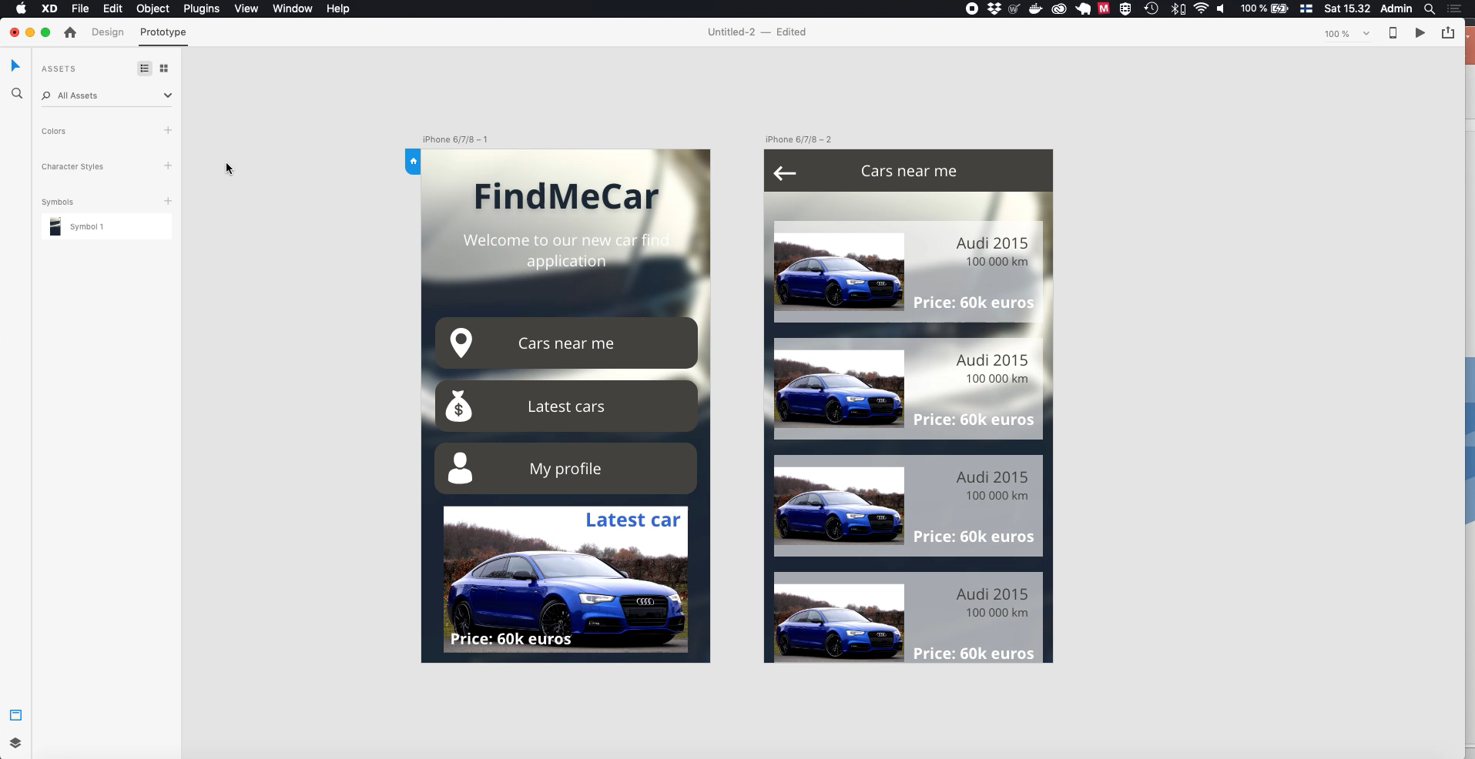

Slide 19
Prototyping
Now we have working prototype.
To test our prototype choose ”Play” button from top right
Other options in this menu are:
Zoom level
Preview on device, this can be used to run protype on actual device, if you have Adobe XD app installed
Play button, to run prototype.
Share button, we will talk about this later
Play button

Slide 20
Prototyping on device (optional)
Protype can be accesed on Adobe XD app on suitable devices.
Once you have connected device on your computer, open Adobe XD app and choose Live Preview
Live preview

Slide 21
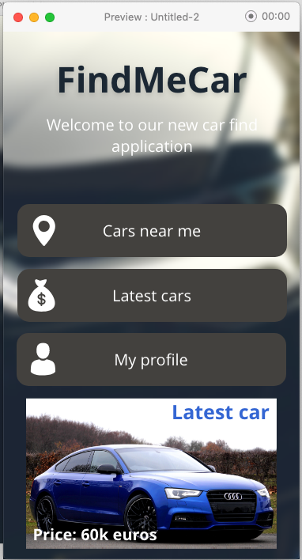
Prototyping
When prototype is playing, it starts from first page.
And when playing, you can access interactions you have created.
Also its possible to record using of prototype
First click of record button starts recording
Second click stops recording, once record ends you are asked location where to save recording. This is useful if you want to test prototype with real users and then later check how they used prototype.
Record button

Slide 22


Slide 23
Sharing prototyping
To publish prototype you need to be signed in to Adobe XD
Choose ”Help -> Sign in” to sign in
If you don’t have account you need to crate free Adobe account.
Then use Share button and ”Publish prototype”
On Share menu you can also access your old prototypes.
Once prototype is shared, user can test it and comment it.

Slide 24
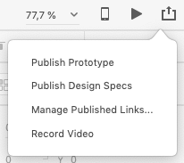
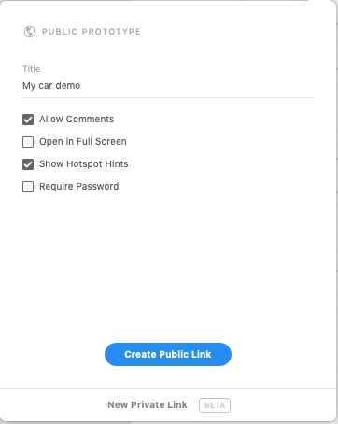
Sharing prototyping
Next you can give title of project
If ”Allow Comments” is enabled customers are able comment your pages
”Open in Full Screen” opens demo in browser as usual, but is directly in Full Screen mode
”Show Hotspot Hints” guide users by highlighting objects that are interactable
You can protect prototype from unwanted usesrs by protecting it with a password.
Last when options are ok choose ”Create publick Link”
Click on ”Publish Prototype”

Slide 25

Sharing prototyping
Copy link
Once project has been shared, you can ”Copy Link” and send it to your client.
Or if you want to see project in browser choose icon on right.
When you view you project trought the link you can also see comments user have given.

Slide 26
Conclusion
We have now gone trough fundamentals of Adobe XD, you should have learnt:
How to create pages and design them by using images, vectors and text
How to modify objects
How create prototype that works trough interaction
How to share prototype to users

